Slide 1
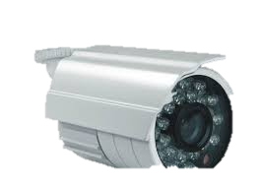

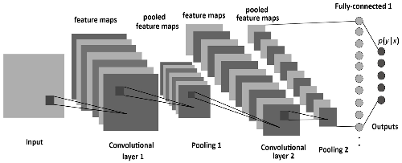

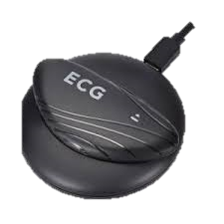
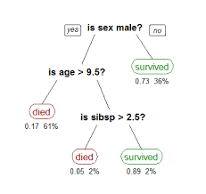
Early Warning System for patient Sunil Mandhan | Sagar P M
Problem Monitor non critical (but under observation) patient at home using wearable and video analytics.
Value Proposition A product targeted for empowering patients to stay at home and regain their personal time.
Event based auto monitoring
Technology
Future Plan Prototype 1: Emotion detection
Prototype 2: Emotion + Rule based system
Final Stage: Emotion + Posture + Rule based
Video/Images
Retrained resnet50
Patient emotion detection
HR, RR, SPO2, BP
Rules/Tree based
Deep learning based expert system

